Slide 1
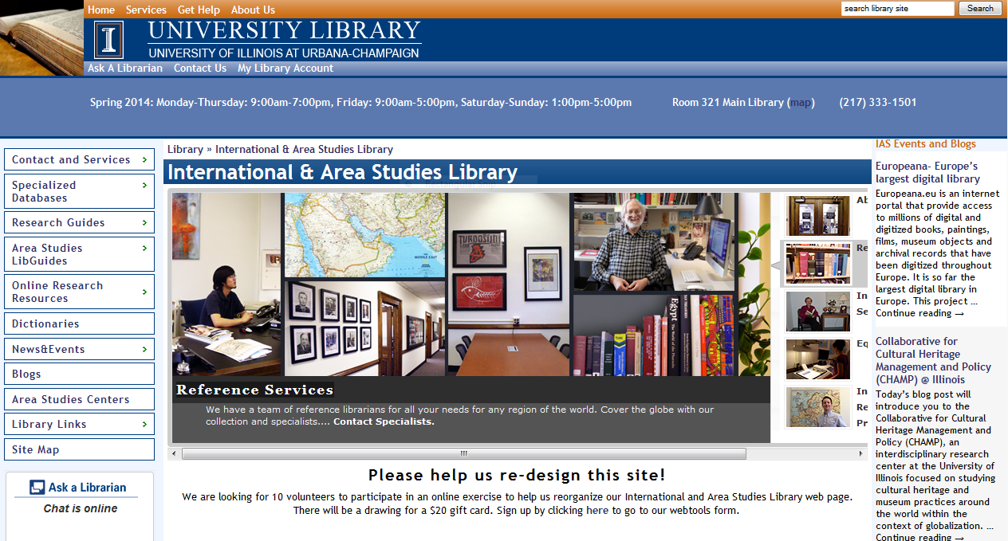
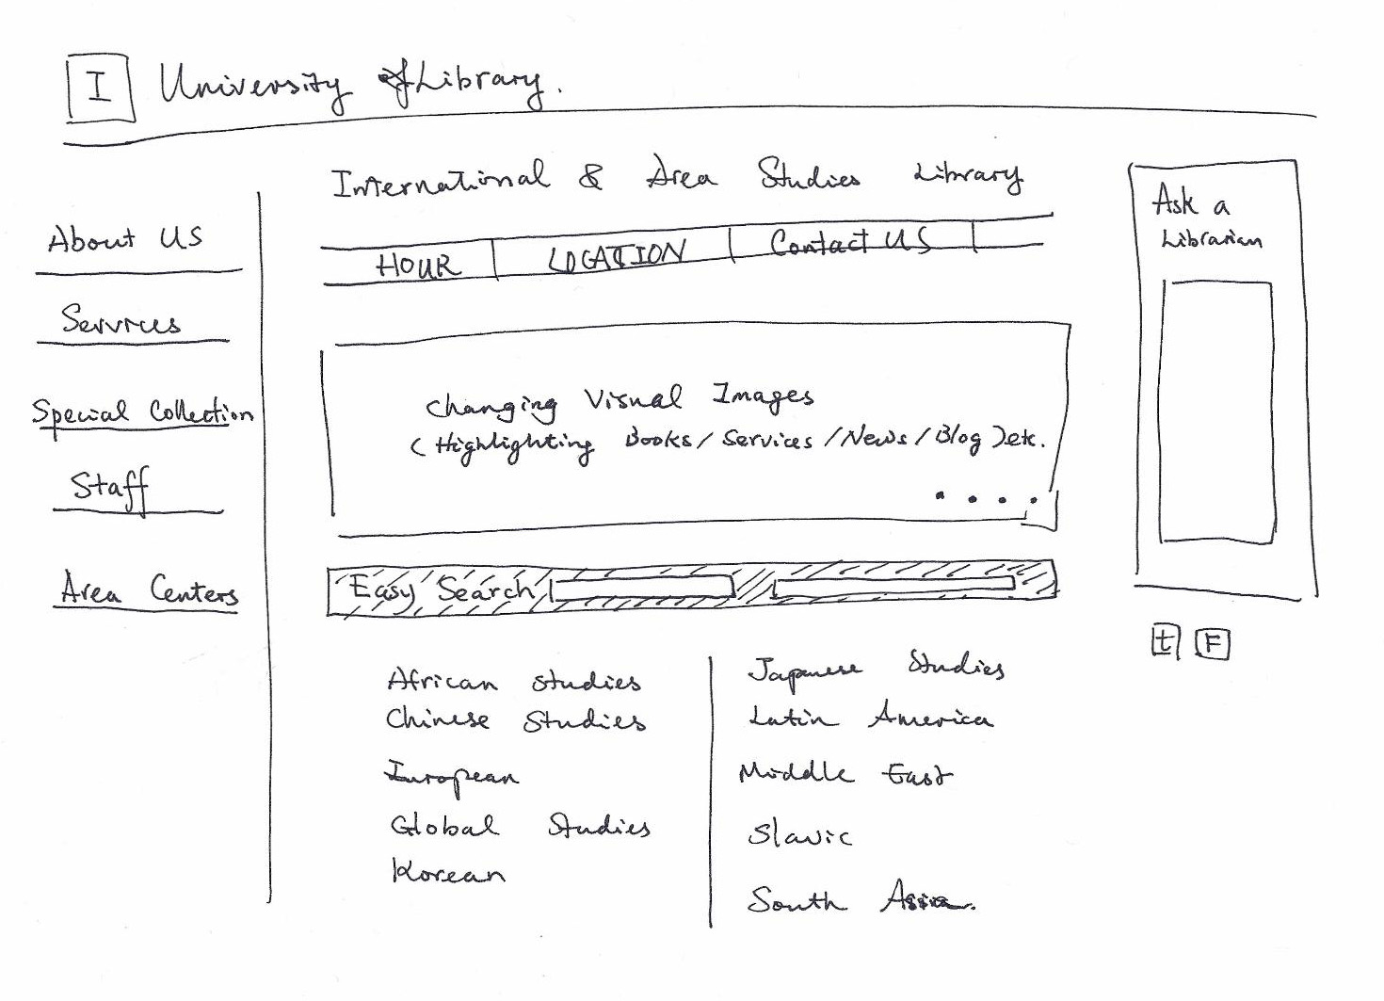
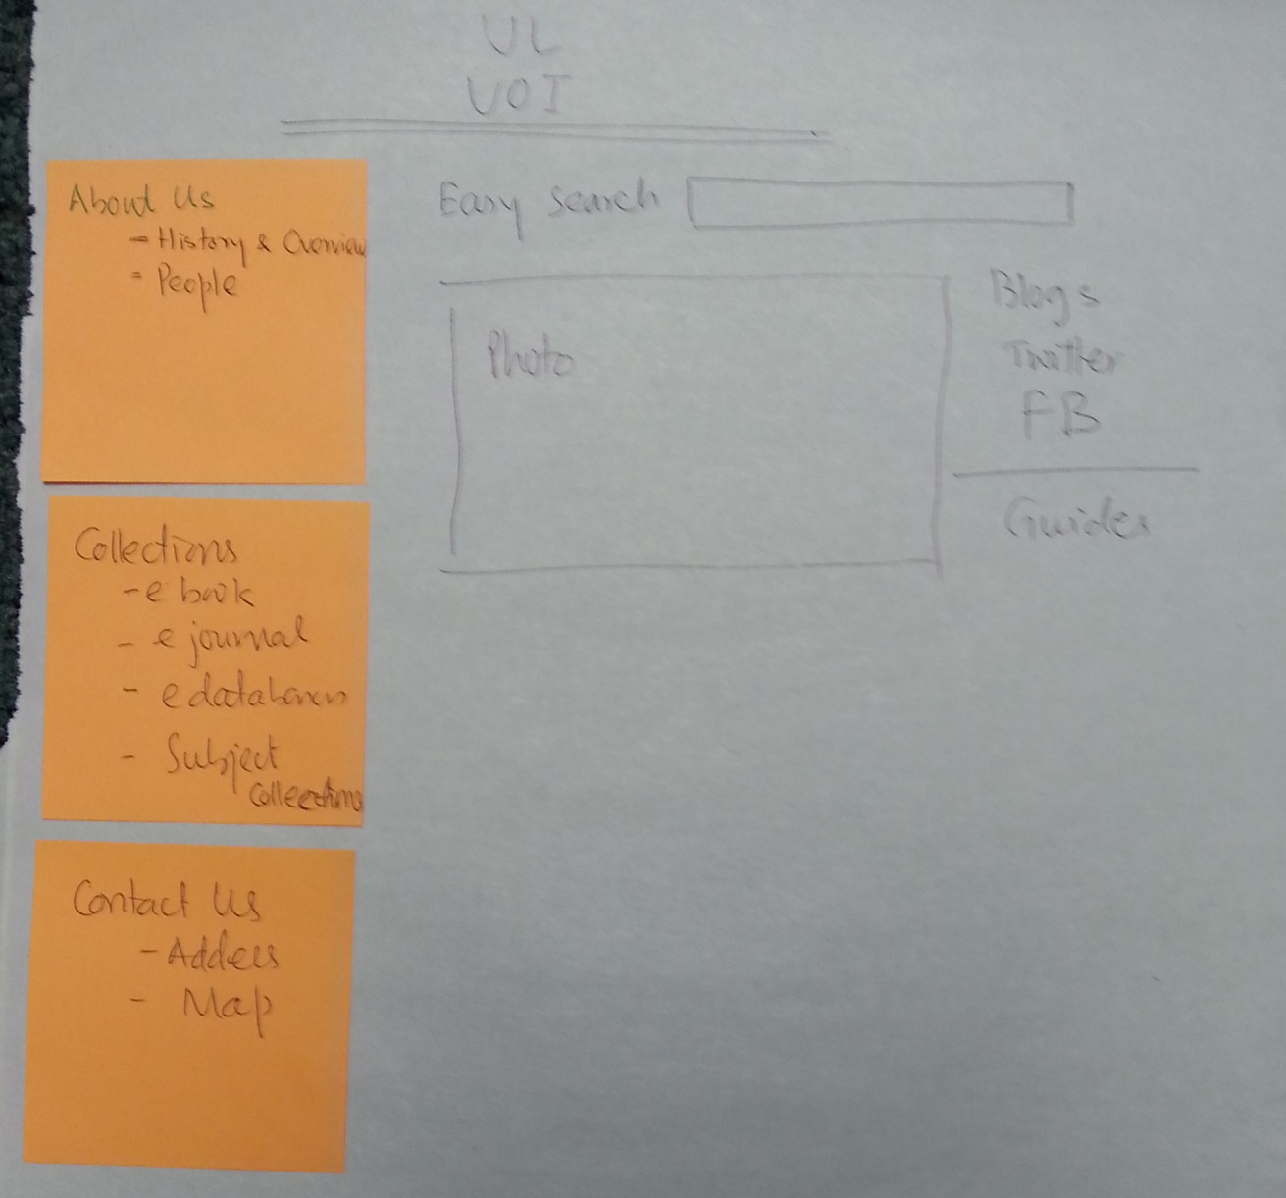
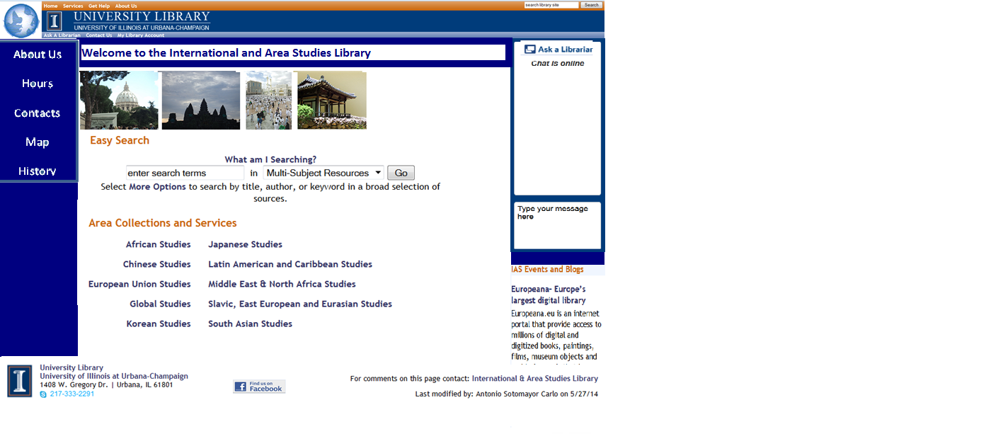
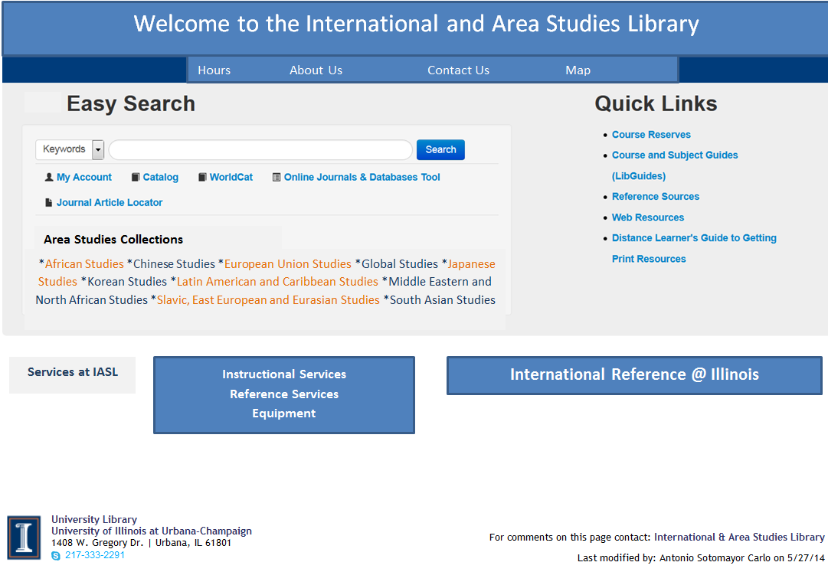
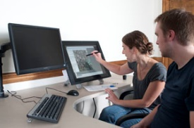
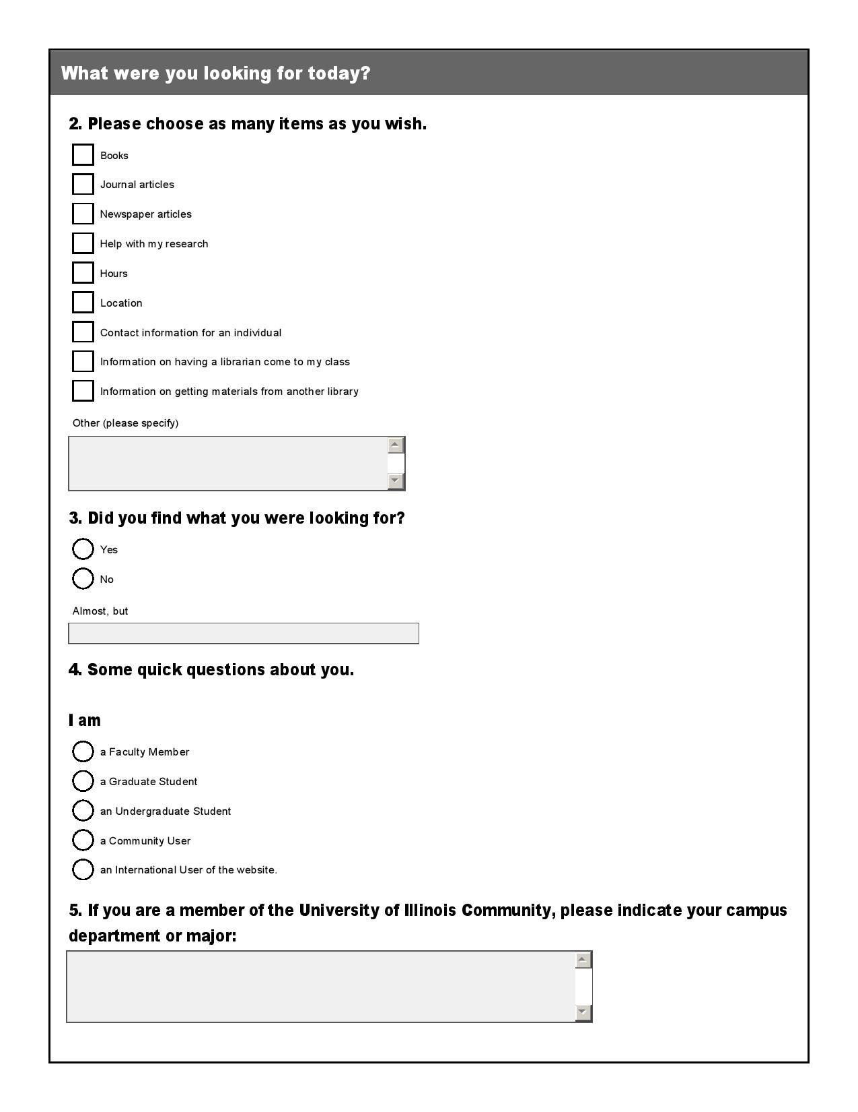
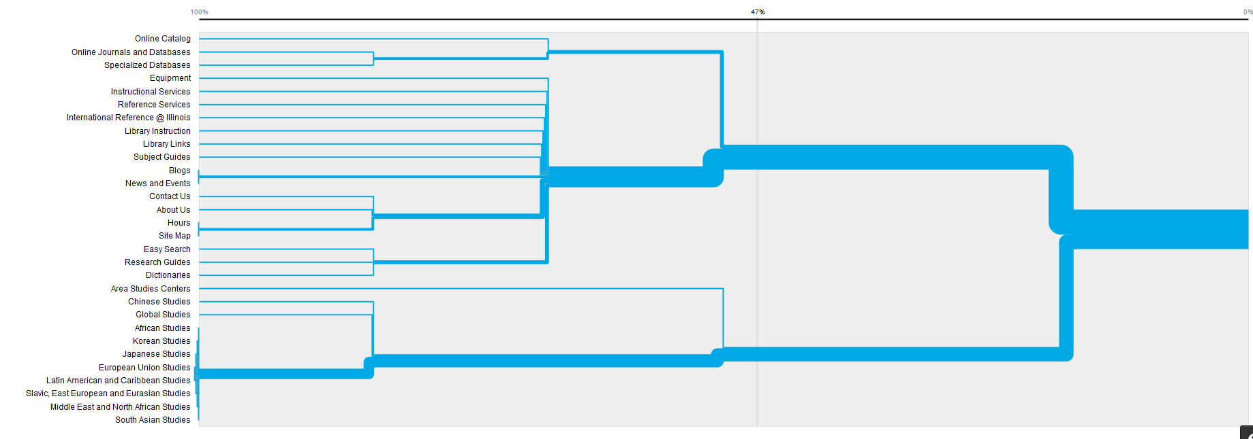
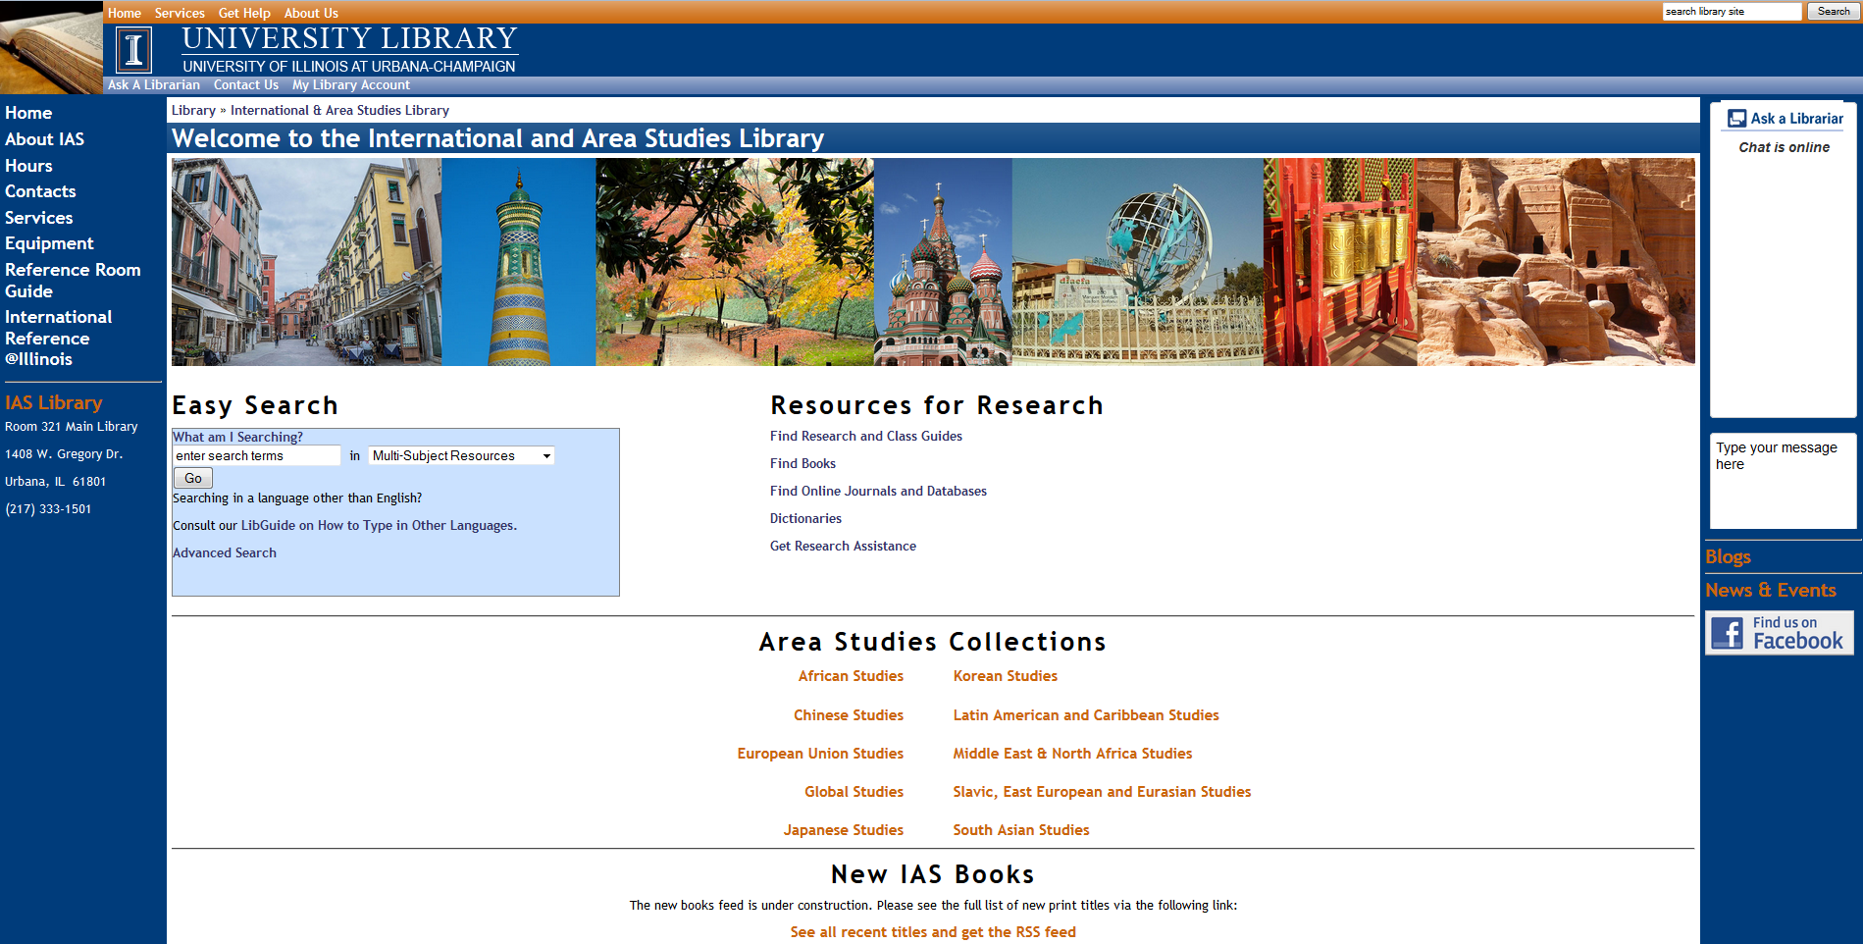
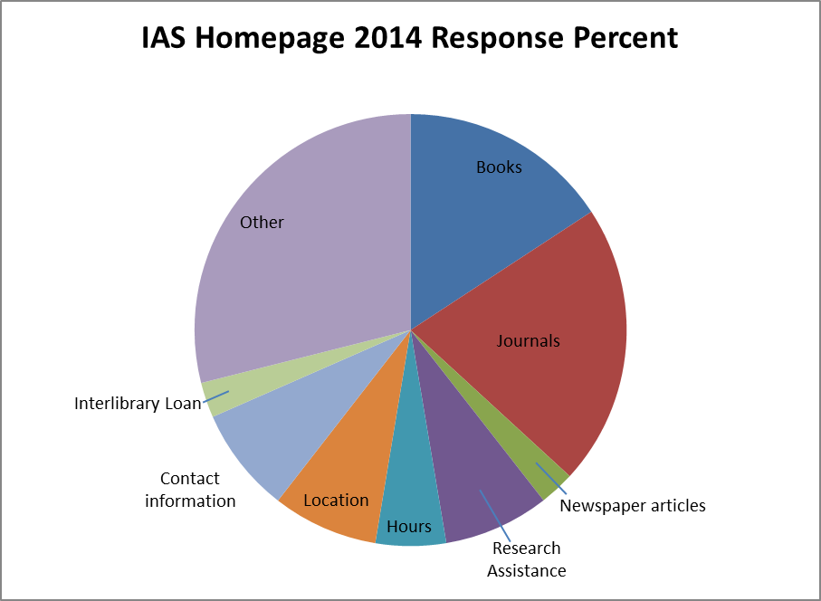
A User-Focused Approach to Redesigning a Library Webpage for a Targeted Audience
A Poster by: Mara Thacker, Sarah Nagle, and Lynne Rudasill
Start
Along with critiquing our mock webpages, users were given a large sheet of paper and post-it notes and asked to draw their own mock up.
Move back
3 spaces– you need more than one focus group!
The International and Area Studies Library (IASL) website was developed during a time of transition using incremental methods based upon the opinions of the faculty and staff in the Library and related departments. Much has changed in the few years since the creation of IASL and its web presence, and the time was upon us to take a look at our website, especially the homepage. We decided to approach this project with an explicit emphasis on user experience in order to avoid repeating mistakes of the past.
4. Usability testing was the final step in the process. We employed the Morae software available in the Scholarly Commons to identify remaining problems with the website. The four subjects who volunteered included undergraduate students and faculty. After each test, problems were addressed and the page was finally launched. We hope to do more testing in the future.
We created mock webpages as a starting point for discussion during the focus groups. These were refined over time and eventually became the basis for the new IAS homepage. The final draft was created in Open CMS and subjected to usability testing in stage 4 of the process.
User experience was emphasized in each step of our four-step process. We took a comprehensive and unique approach in combining established methods of evaluation with new software that enabled new visual analysis tools. After reviewing the use of our page using Google Analytics, the four steps included:
Brief online survey linked from the old IASL homepage.
Online card sort activity.
Focus Groups
Usability Testing
At each step in the process our four-person design and testing team met to analyze results collaboratively.
3. We ran a total of three focus groups, two of which were a mixture of UIUC students, faculty, and staff that we had recruited via targeted emails to area studies classes and area center listservs, and one which was comprised of international librarians who were recruited during their visit for a summer library workshop through the Mortenson Center. Each focus group was given a tour of the old page which they commented on, then a tour of a few mock-up ideas which they gave feedback on, and finally we had an activity that asked them to design their own home page. Participants were incentivized with a pizza lunch during the focus group, and the participants in the first two focus groups received $20 gift cards.
Lessons Learned:
There are many, very useful tools available online that allow quick and helpful feedback for website re-development.
Take a good look at your starting point by using the information available in any current statistics you can find such as Google Analytics.
Be sure to properly incentivize study participants for a better range of responses.
Encourage the participants to show you exactly what they want.
Be assured that everything will take longer than you thought.
Do not go into the experiment with preconceived notions of how things should look.
Pay careful attention to accessibility.
Dendogram
Dendogram Generated by OptimalSort Software
1. Online Survey
Go back two spaces and refine your recruitment technique– you did not get enough responses!
2. Rather than a traditional card sort activity, we sought an online product that would make the experience more interactive for participants. Based on the availability of a free version, we chose to use OptimalSort. There may be other better products available. OptimalSort allows users to sort the labels for items in a website into groups, add and subtract terms being used. This gave us a better understanding of how users make use of the resources on the IAS website. The software creates a dendogram – a visualization of the ways that users grouped the website content.
Finish

